Slide 1
RGB LED Lighting Shield for ARDUINO

Slide 2
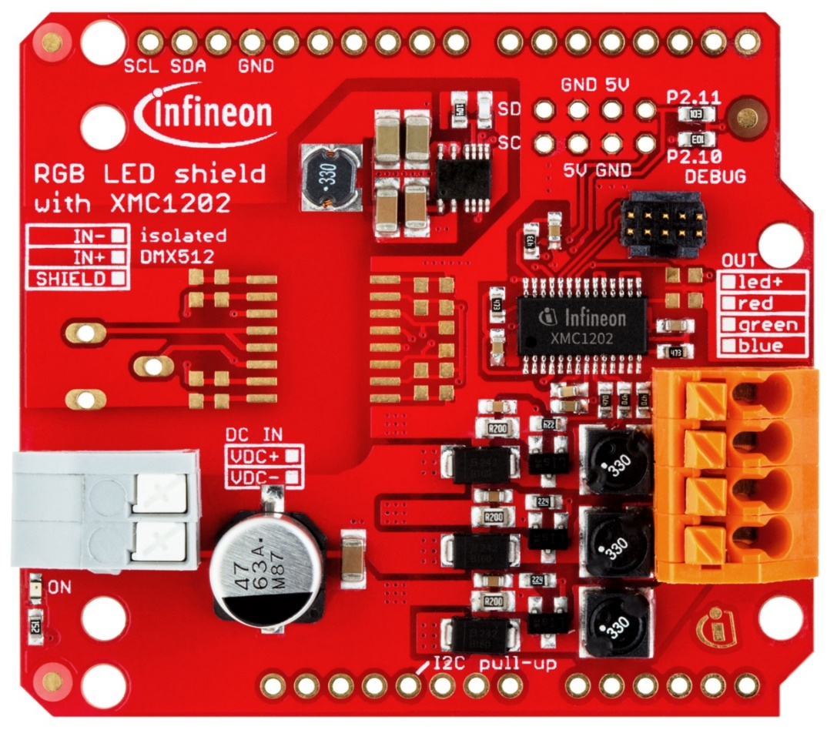
RGB LED Lighting Shield
FEATURES:
- XMC1202 Microcontroller with 16K Flash.
- 3 independent output channels.
- Up to 48V DC input.
- Up to 700 mA output on each channel.
- Connectivity: I²C, isolated DMX512 (n.m.).
- Compatible with Arduino Uno R3 and XMC1100 BootKit.
CURRENT CONTROL SCHEME:
- Peak-current control with fixed off-time.
- Pulse density modulation.

Slide 3
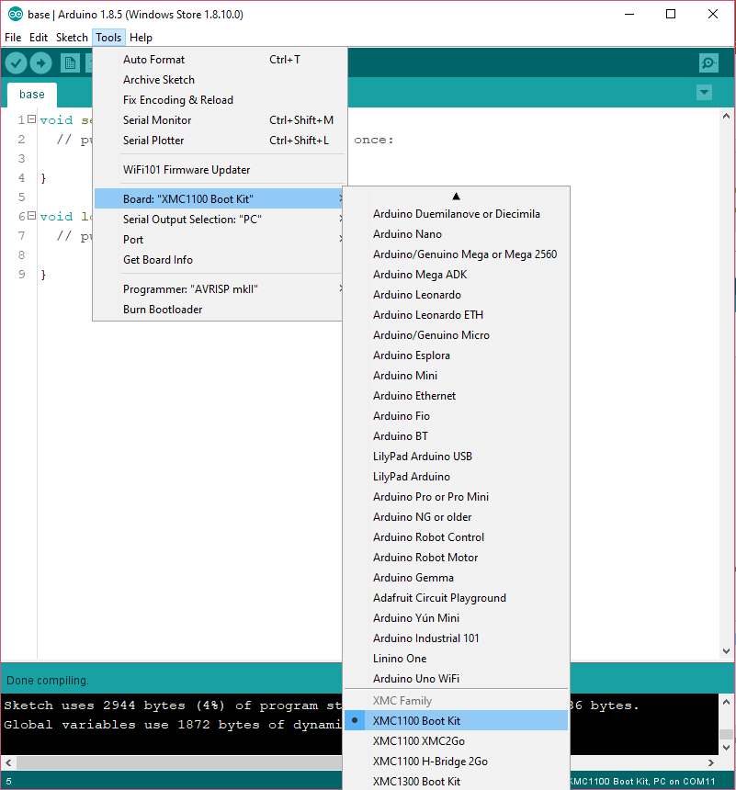

XMC for ARDUINO
NOTE: You can use INFINEON RGB LED shield with XMC microcontroller family or with Arduino.
To be able to select XMC board you need install additional boards.
ArduinoIDE

Slide 4
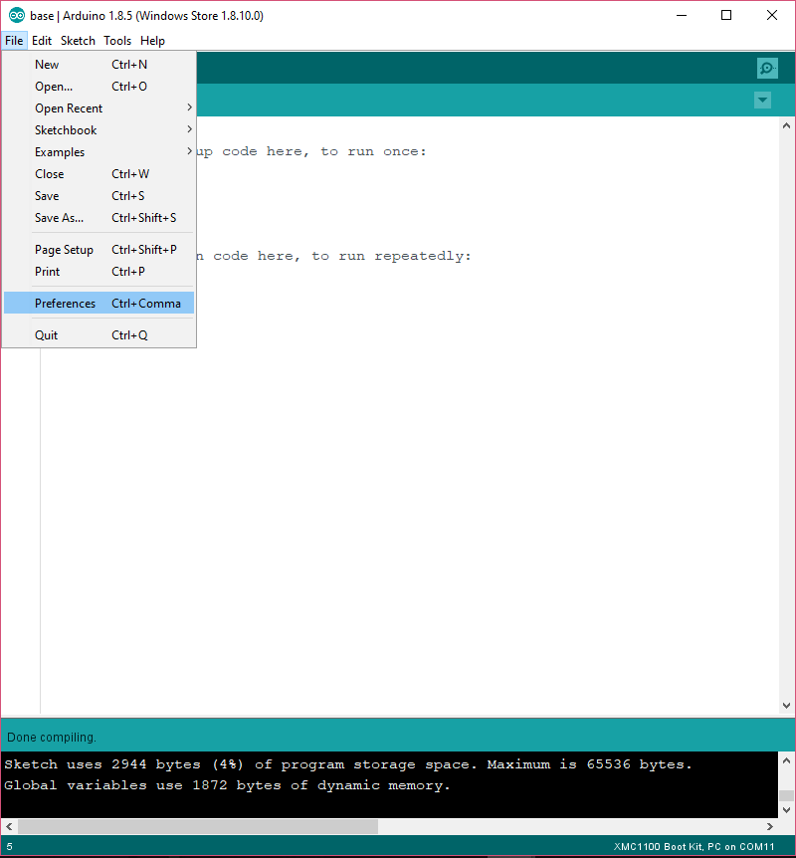
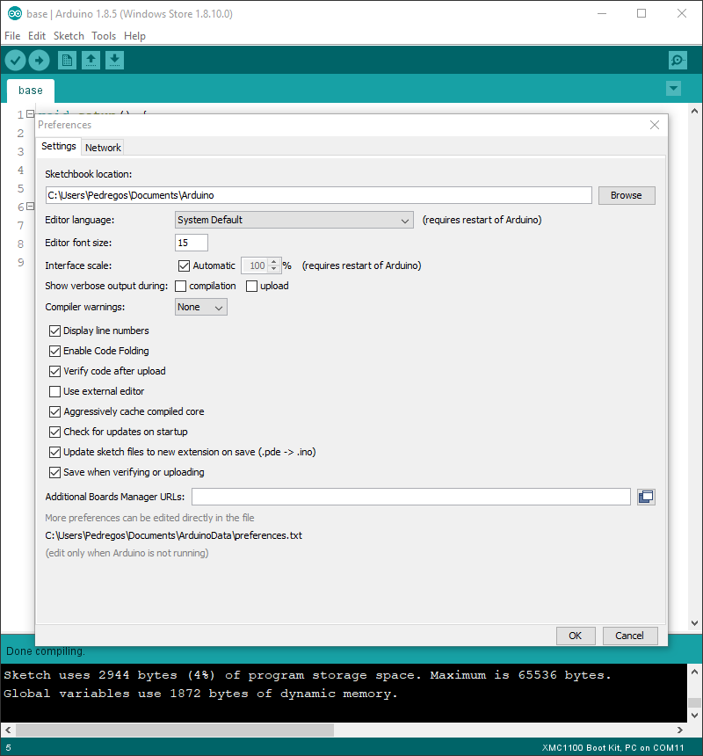
Install XMC boards in ARDUINO IDE
https://github.com/Infineon/Assets/releases/download/current/package_infineon_index.json

Slide 5
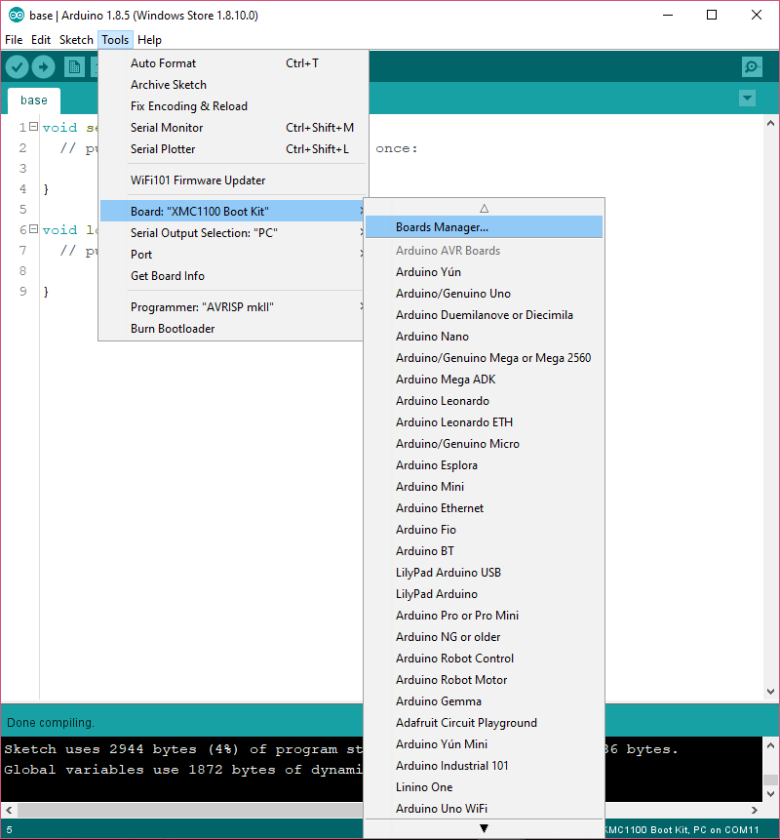
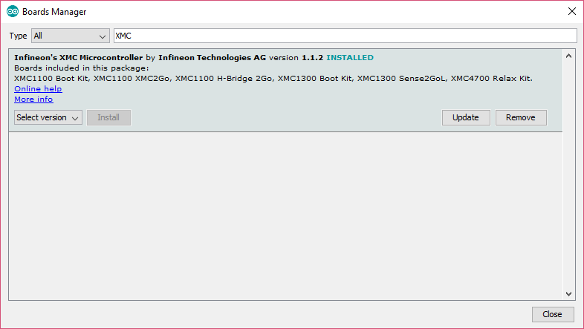
Install XMC boards in ARDUINO IDE
This is a sumary, you can find the complete instruction in GitHub/Infineon:XMC-for-Arduino/README.md

Slide 6
EXAMPLES: Analog RGB LED strip
In these examples, an analog LED strip is used.
What does this mean? With the analog RGB LED strips you can choose the color of all LED strips, however with the digital RGB LED strips you can choose the color that each of LEDs.

Slide 7

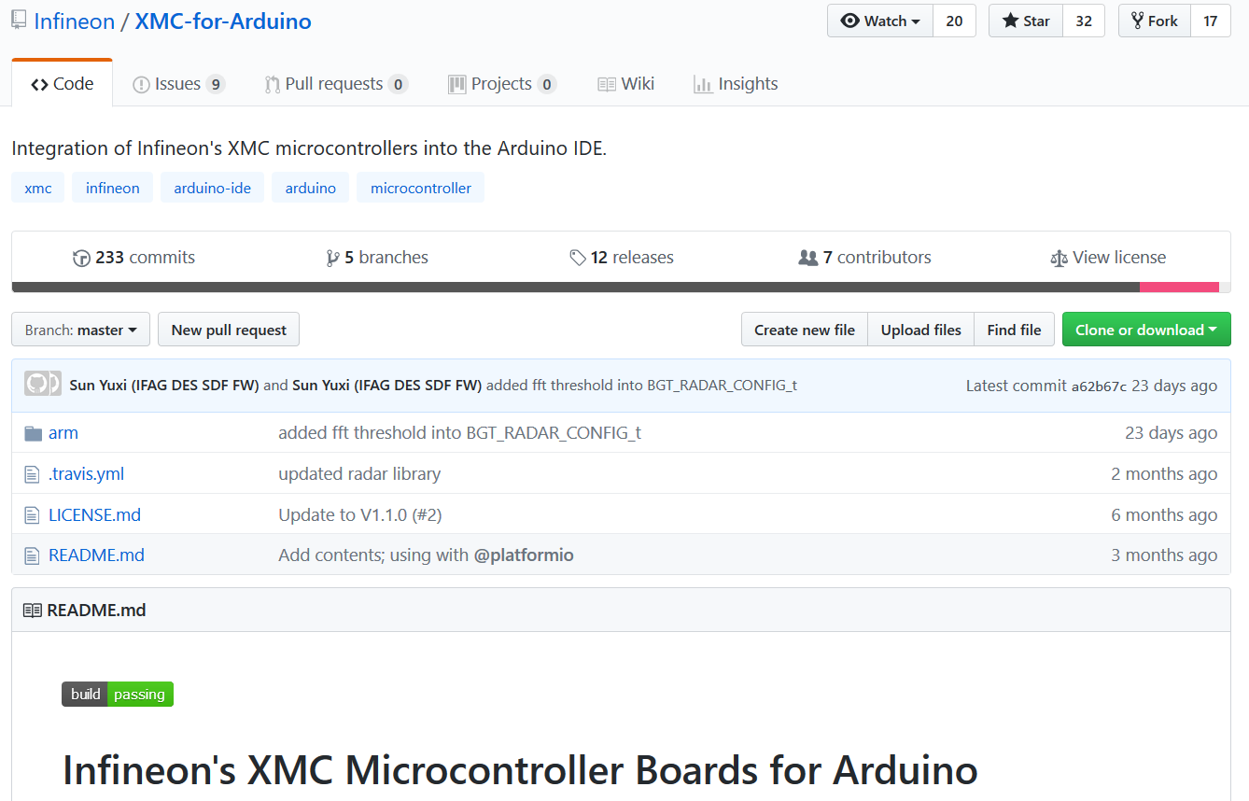
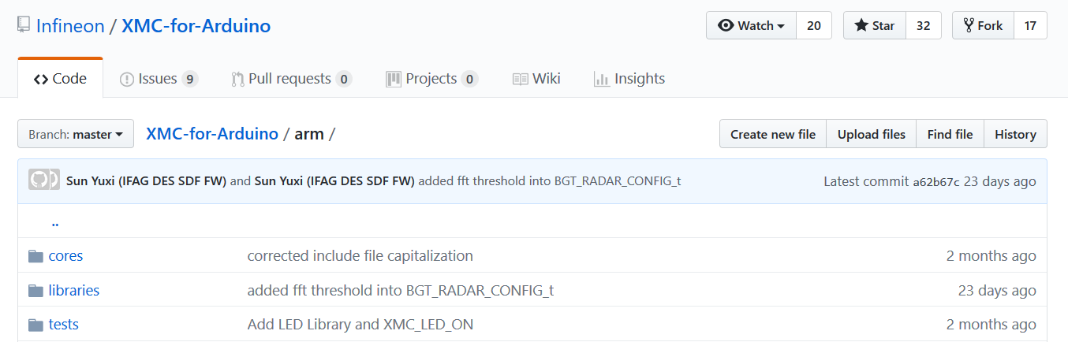
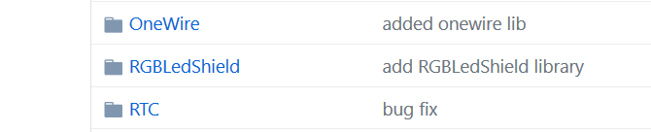
Examples: Dowload Library
Github

Slide 8
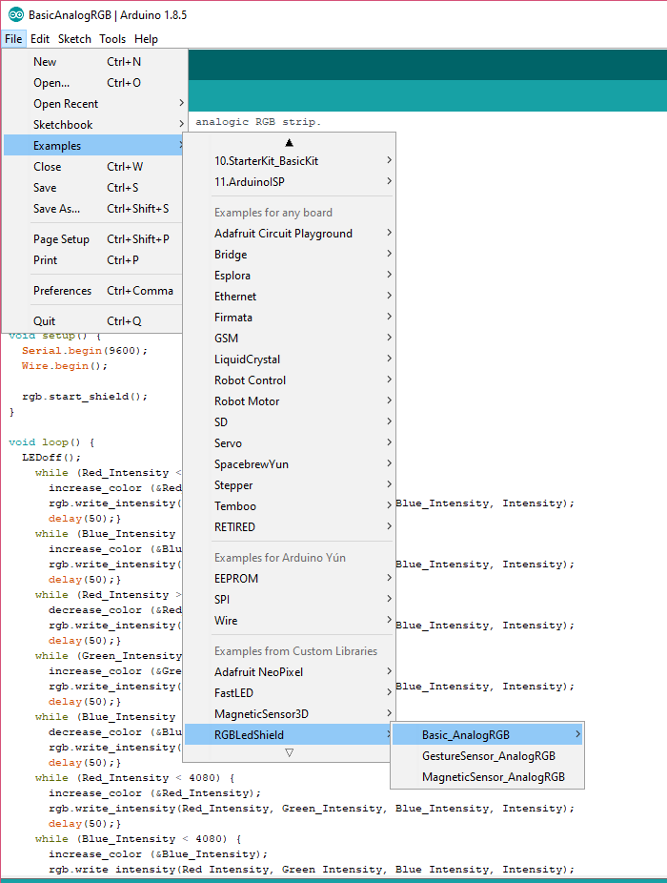
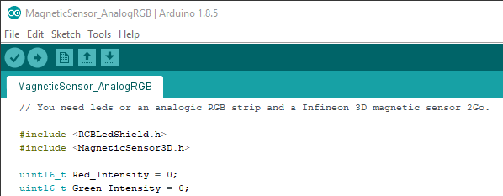
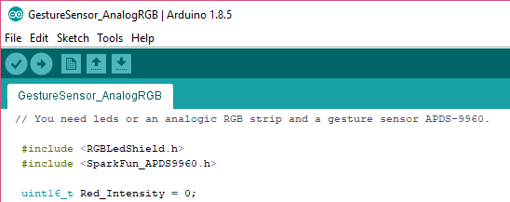
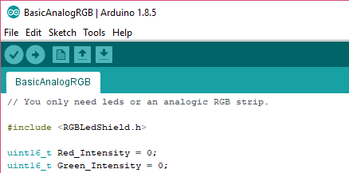
Examples:

Slide 9
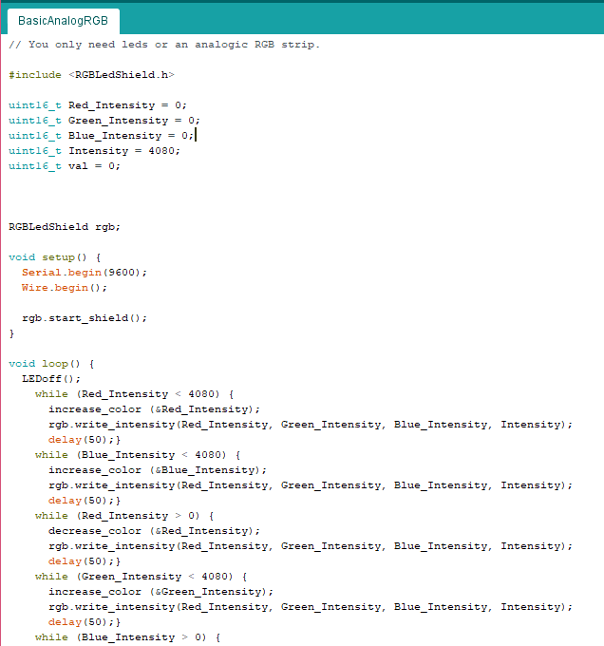
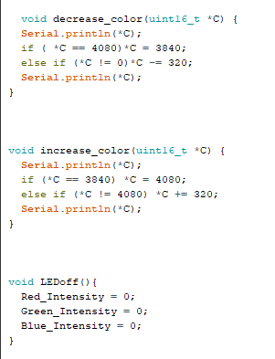
EXAMPLE: Basic Analog RGB
In this example, you need only an analog LED strip.

Slide 10
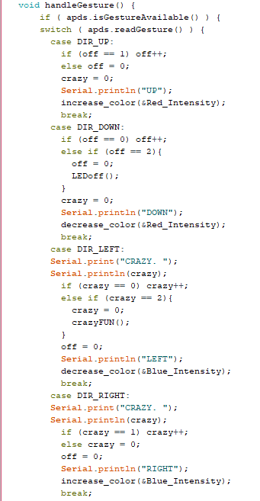
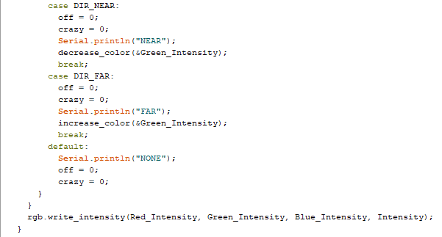
EXAMPLE: with Gesture sensor
In this example, you need an analog LED strip and a gesture sensor APDS-9960.
NOTE: DOWN+UP+DOWN = LEDoff() LEFT+RIGHT+LEFT = crazyFUN()

Slide 11
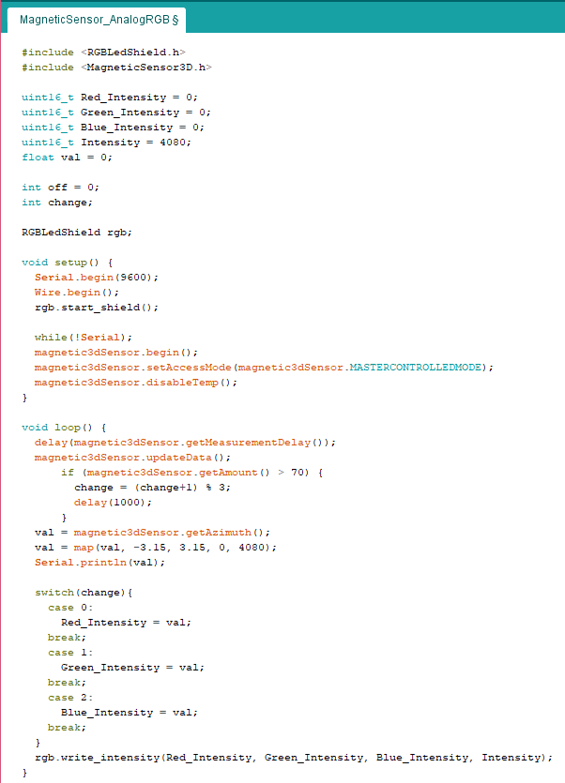
EXAMPLE: with Magnetic sensor
In this example, you need an analog LED strip and an Infineon Magnetic Sensor 2D.
You can find more information about this sensor for Arduino IDE in:
Github/Infineon

Slide 12
Source Code
It does not work? The RGB LED Lighting Shield may not have the Source Code loaded.
To solve it you have to download the Source-Code and upload it to the board with DAVE.
Infineon Products: RGB LED Lighting Shield with XMC1202
This is the only step in which DAVE is used and it is not even a mandatory step!
NOTE: The board has this code by default, so this souldn‘t happen.

Slide 13


Source Code
To download Source Code:

Slide 14
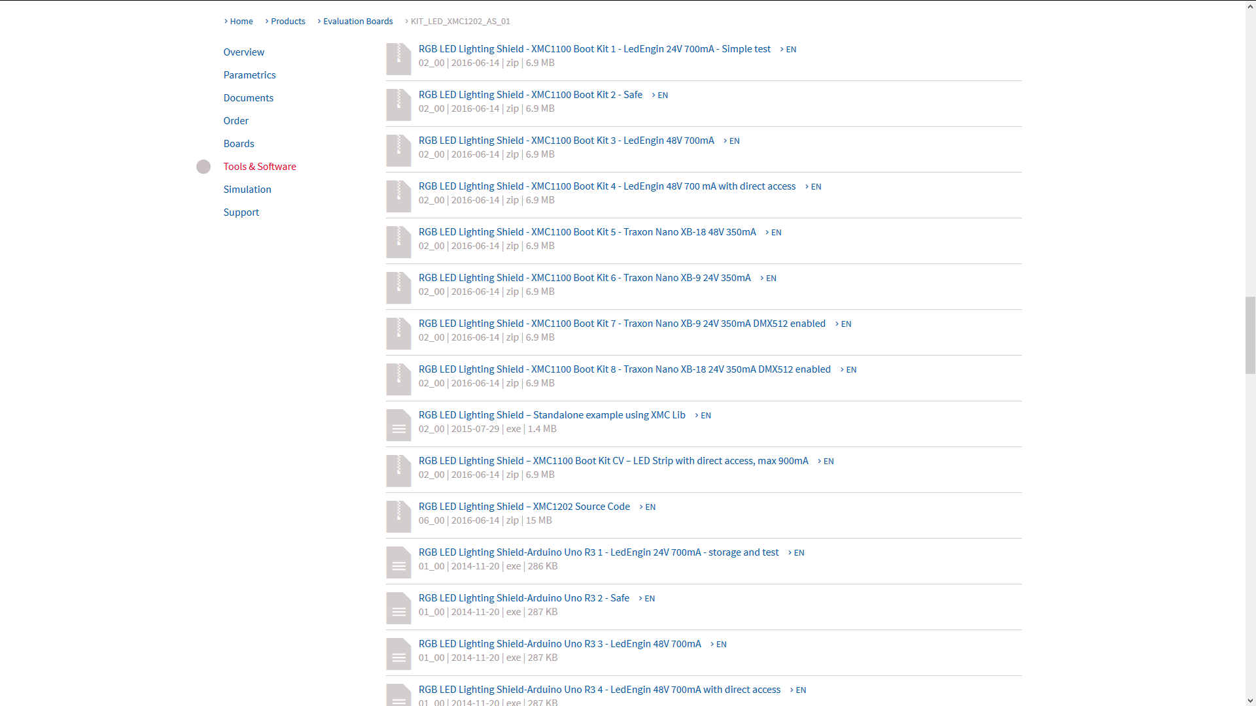
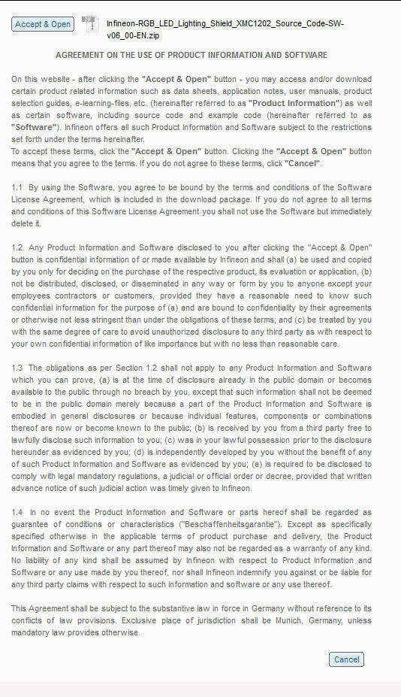
Source Code

